Slide 1
DXC – Realtime Project
Name:- md EHTESHAM
Reg_no:- DXC262AB12039

Slide 2
1.Connected Vehicles
2. AP Morgan Data

Slide 3
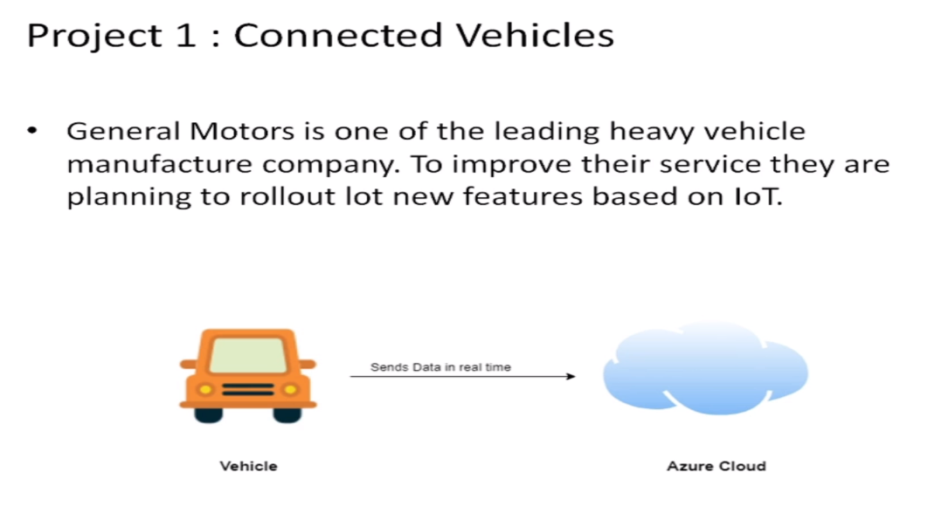
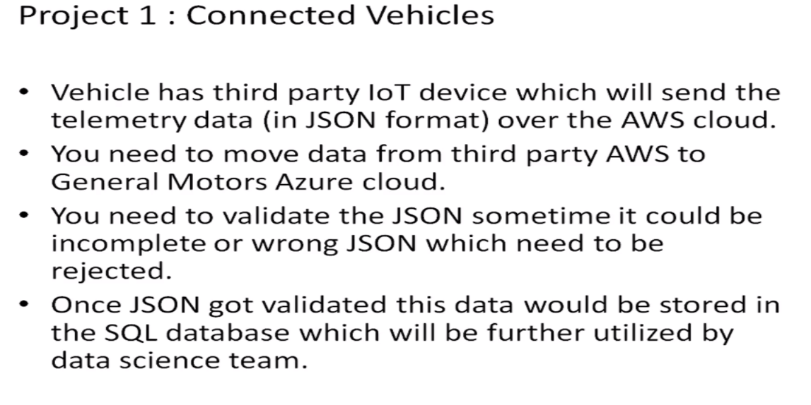
Project - 1

Slide 4
TASK 1:
Create Azure Data
Factory Account For
Data pipelines

Slide 5
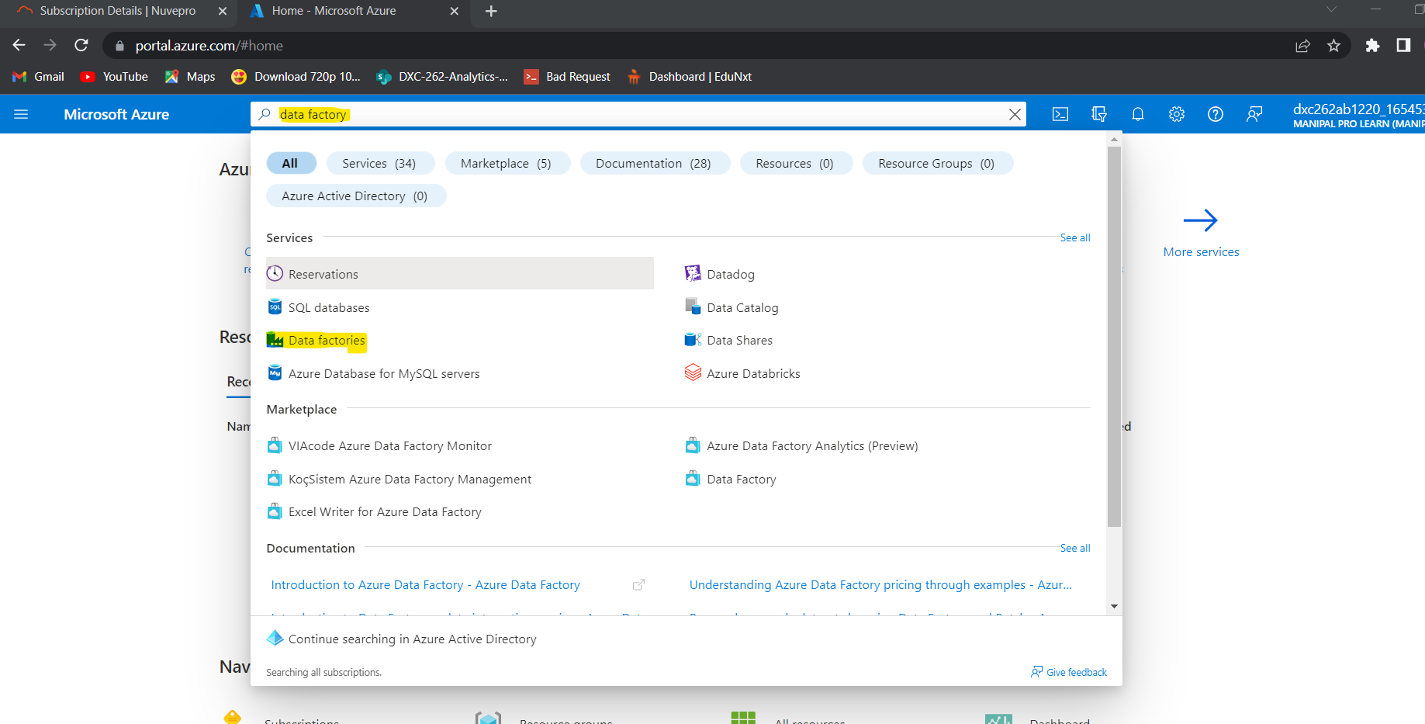
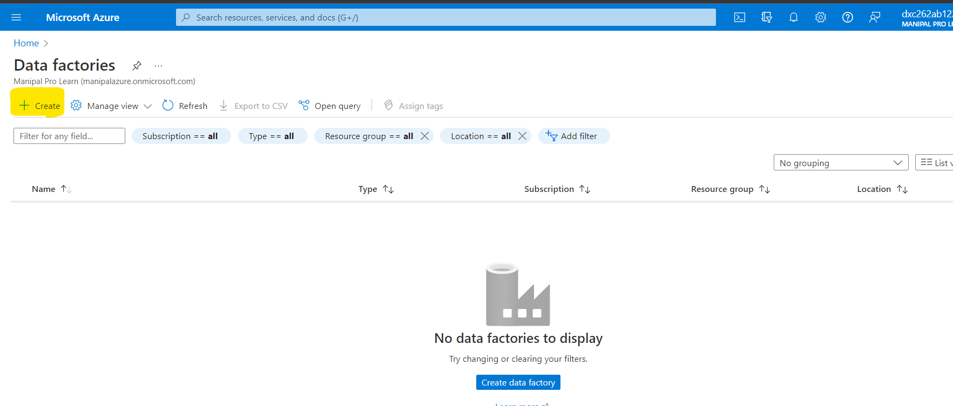
Open Azure Portal Website and in the search bar, Search data factory and click on Data Factories.
Click on +Create option.

Slide 6
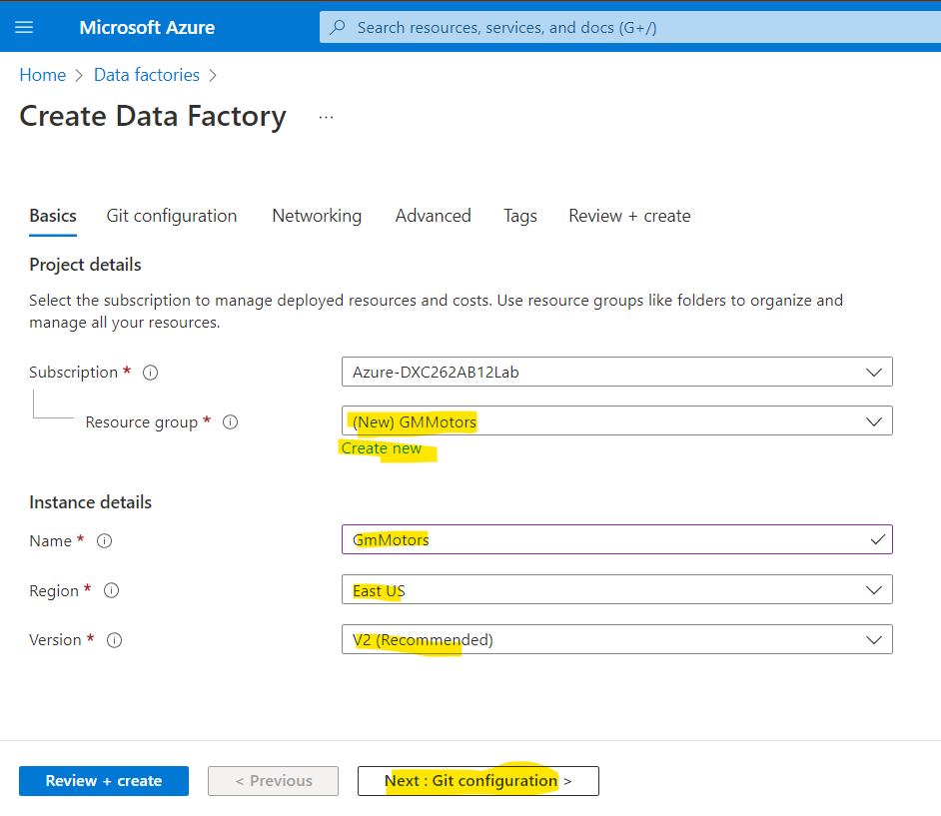
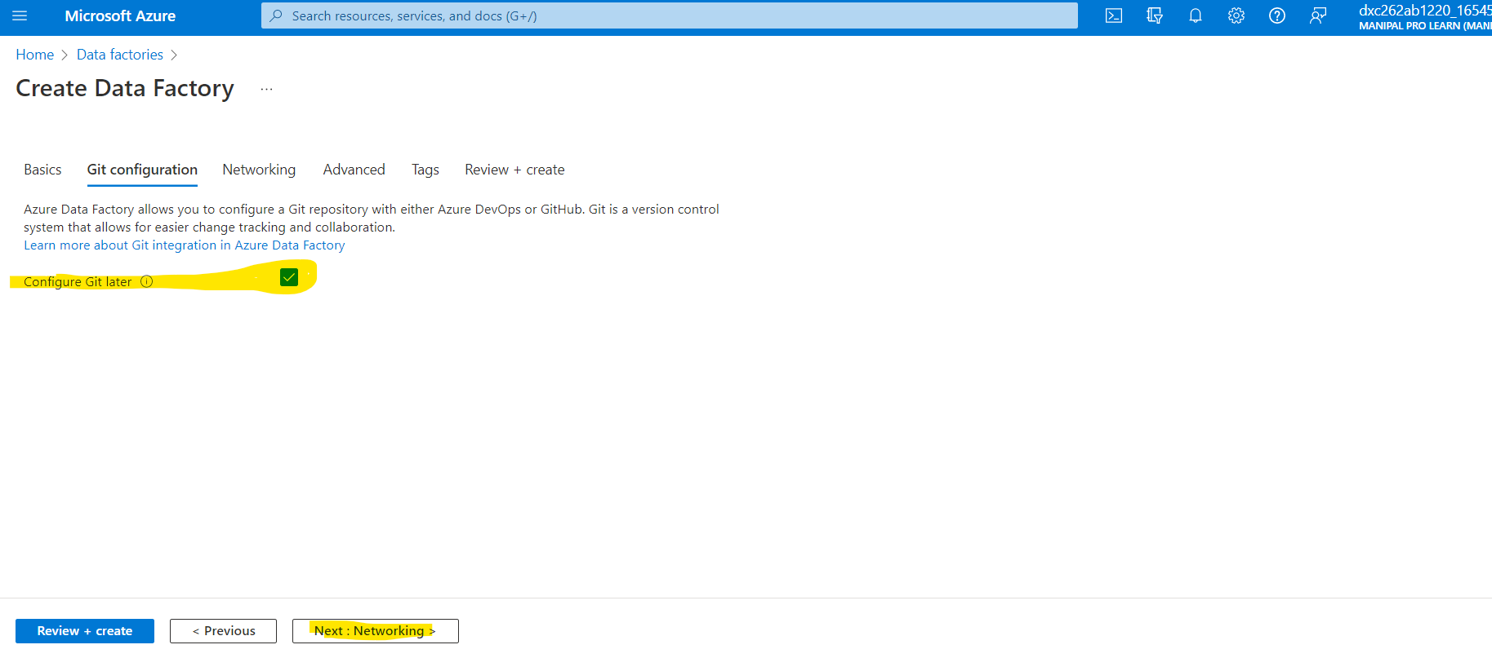
Create resource group if not created and Fill the name for Data Factory and click on next.
Check box for Configure Git later and click on networking.

Slide 7
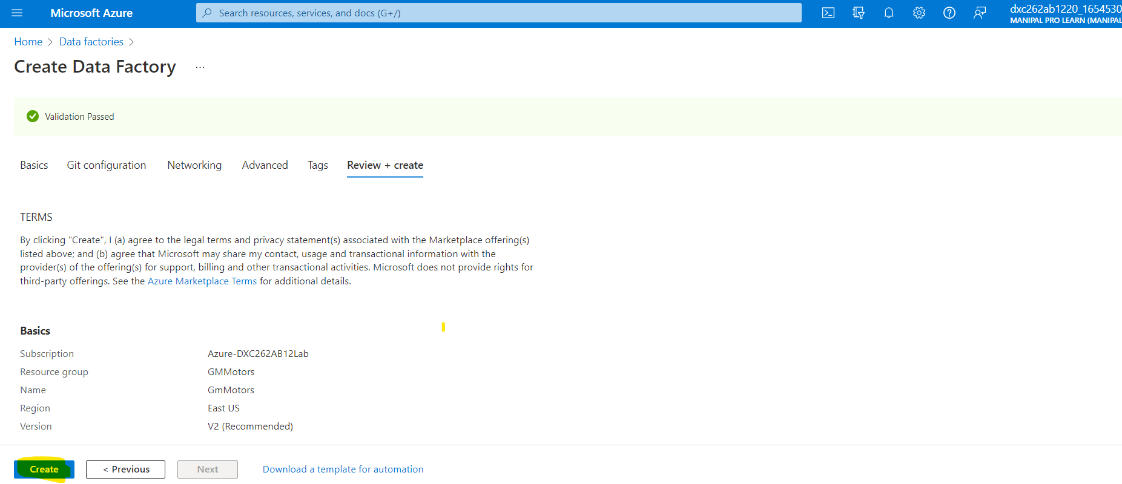
Click on create button.
Now you can see the deployment is
Done after deployment Click on
Resource.

Slide 8
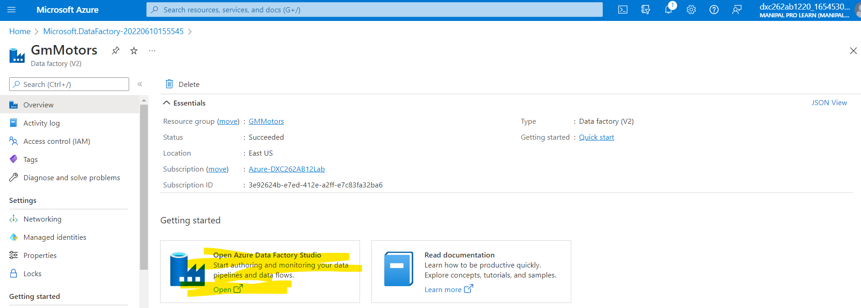
Open Azure Data Factory Studio.

Slide 9
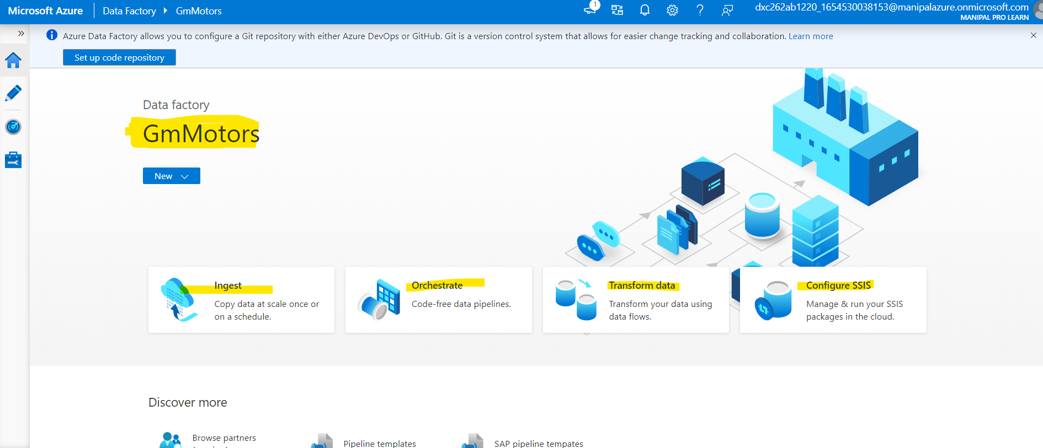
The Azure Data Factory will be created.
Now We will Create the
Storage account

Slide 10
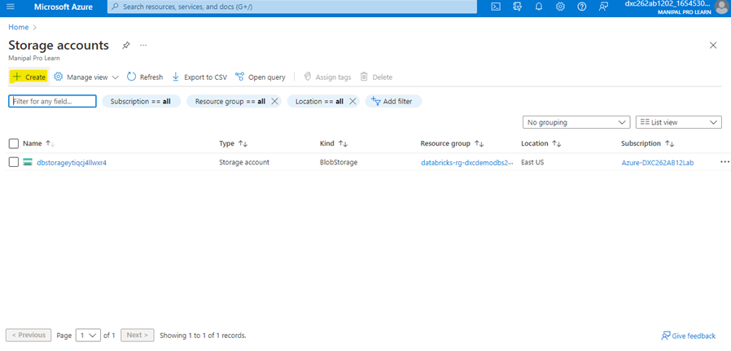
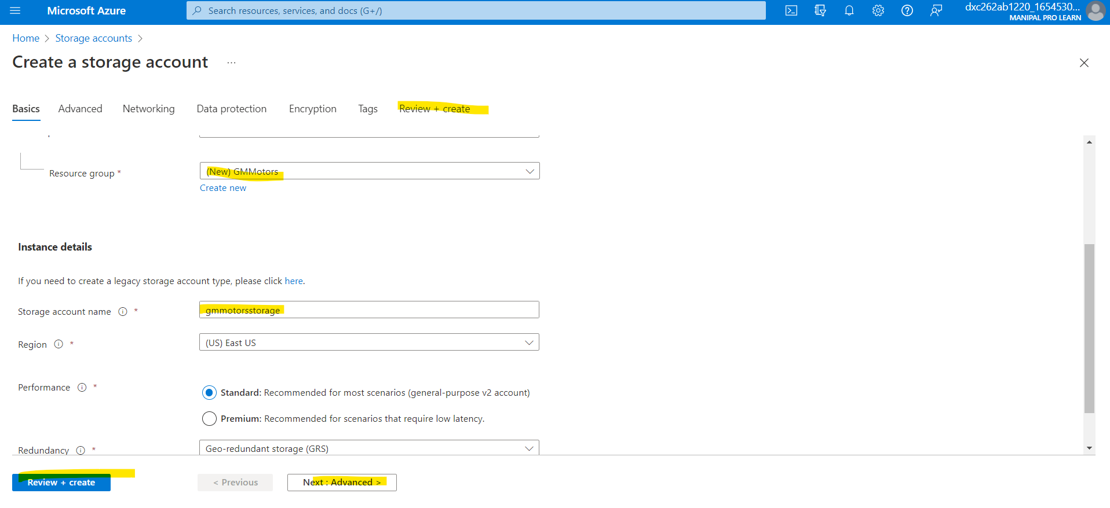
Go to Azure , search for storage. Click on Storage Account. Click on + Create.
Fill up all the details and click on Review+Create. Deploy it :

Slide 11
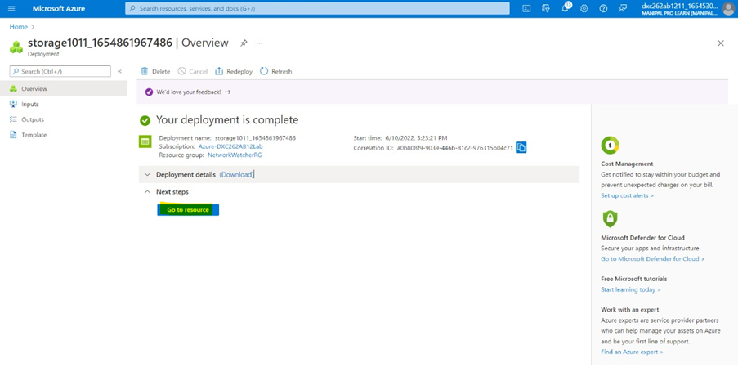
Once deployment is done click on go-to resource.

Slide 12
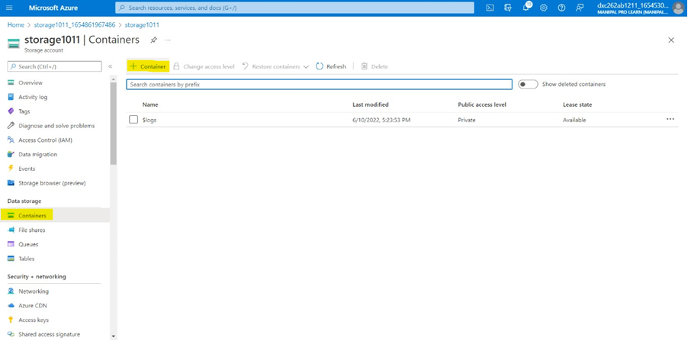
Container → +Container
Navigate to containers and click on
+ Container.

Slide 13
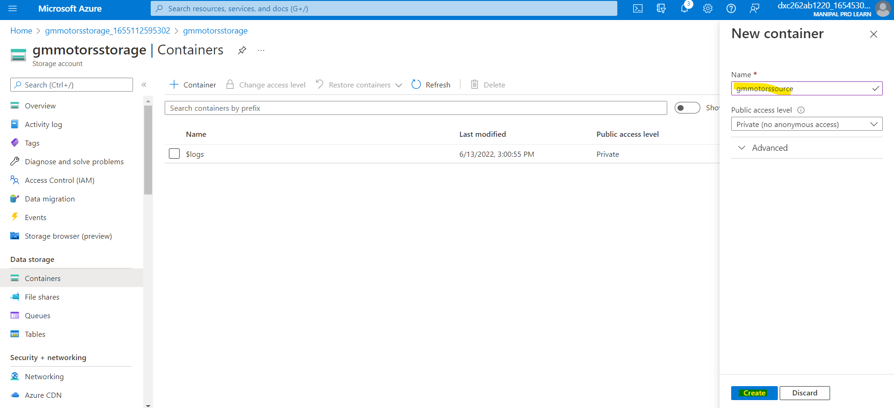
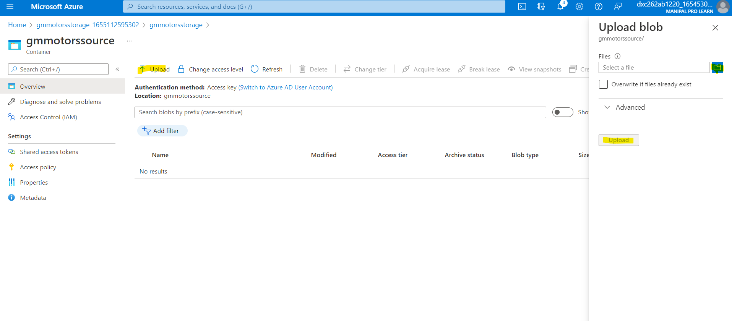
Container is used to create source and destinations to store the data. Click on create.
Click on container and then click on upload and select the file and upload.

Slide 14
TASK : 2 Now we will create
the Sql databases..
→Refrence video for creating:-
refrence video

Slide 15
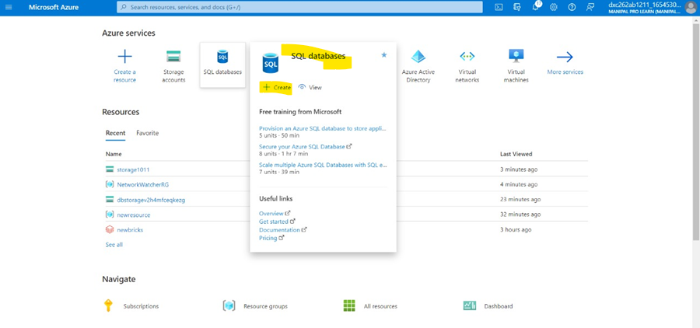
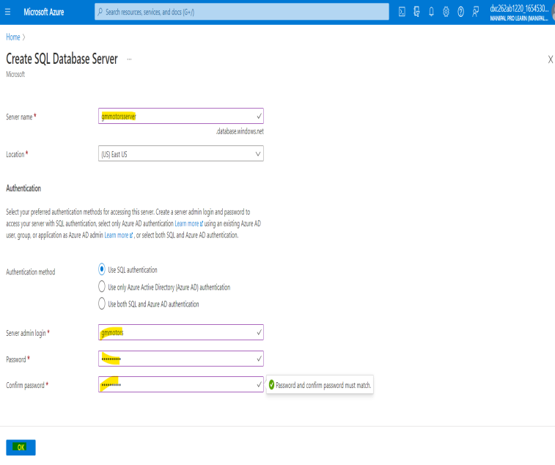
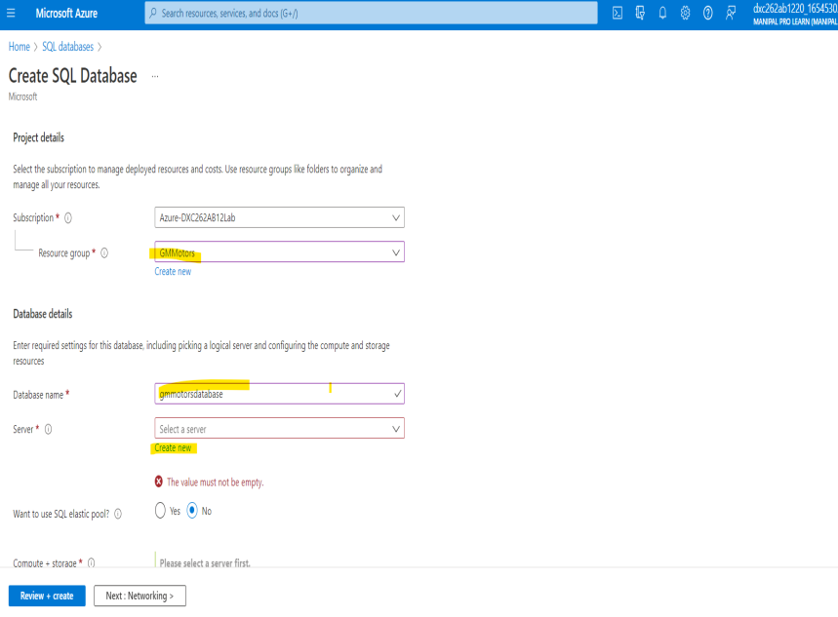
Now we need a SQL database. Search for SQL DATABASES and click on +create.
Fill the required details and click on create.

Slide 16
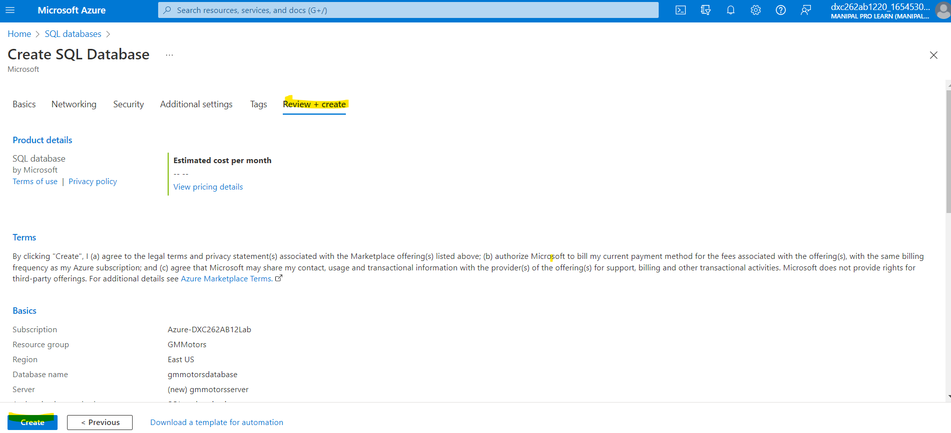
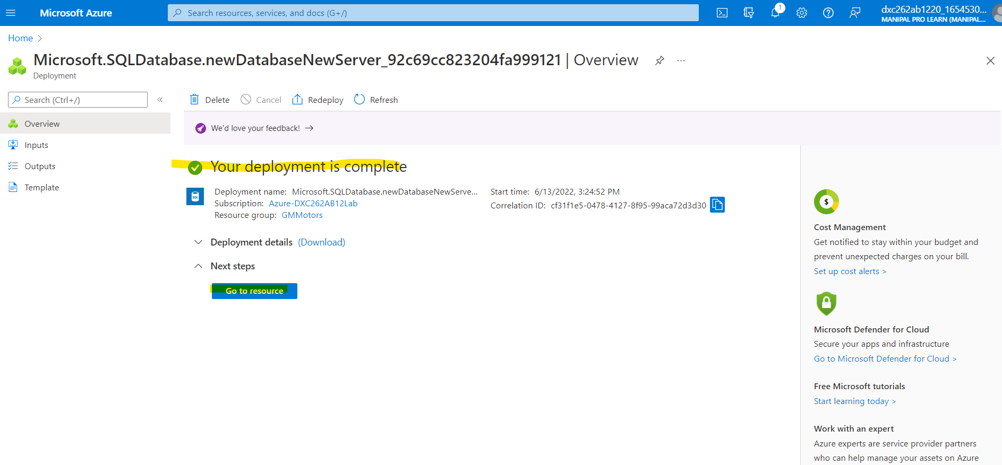
Click on Review + Create and then click on Create.
After deployment is
completed,
Click on go to
resources.

Slide 17
TASK 3: create a pipeline
that will take data from
blob storage and feed into the SQL database
Refrence_video

Slide 18
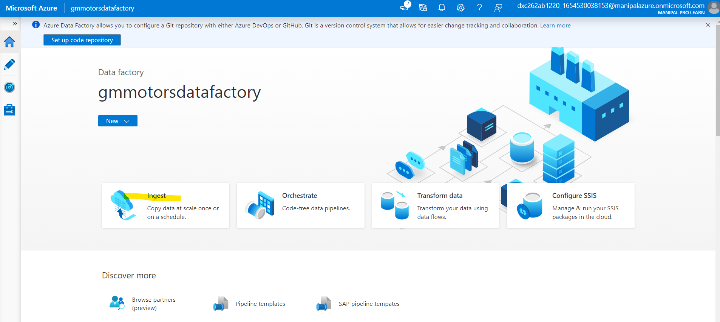
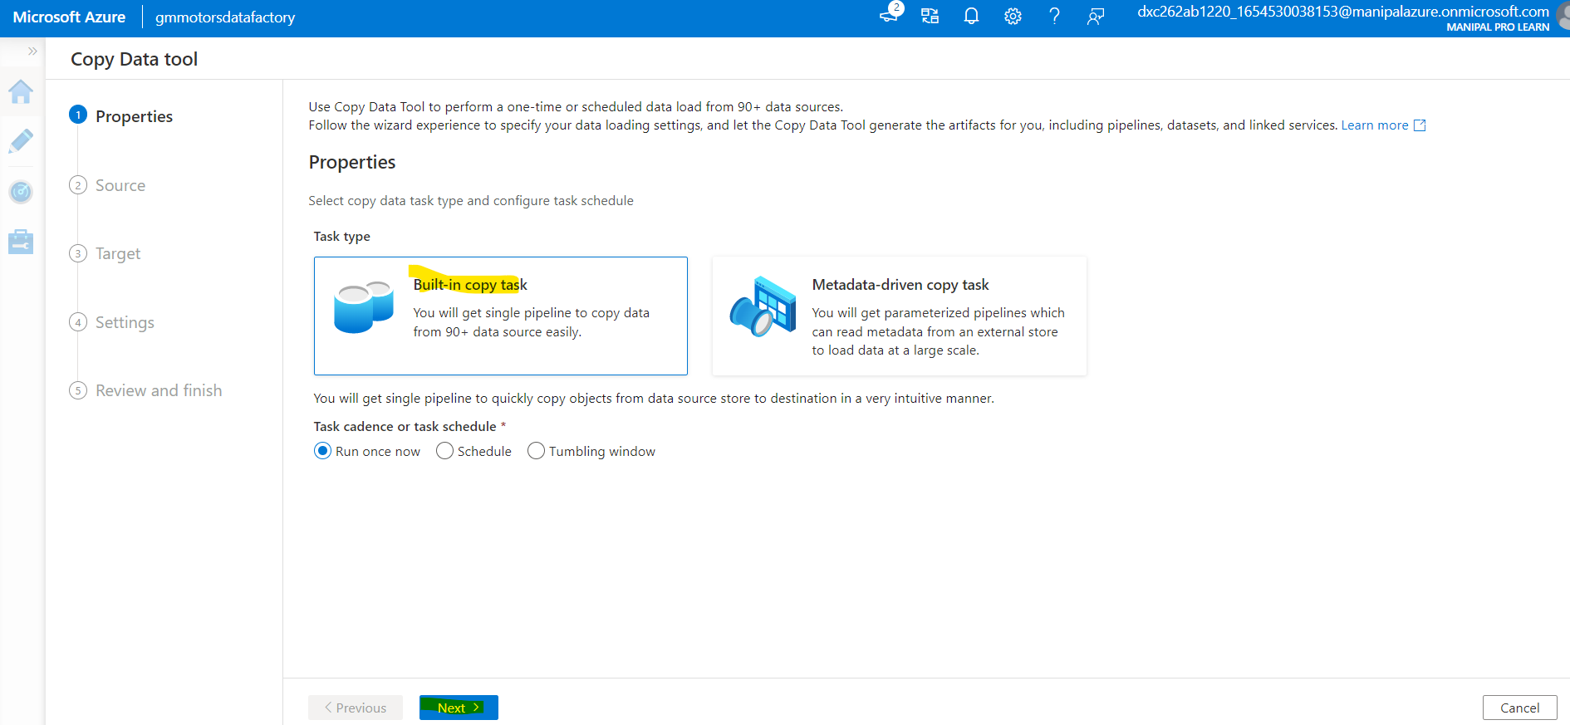
After these steps come back to Azure Data Factory Lab . Here we need to create a pipeline that will take data from blob storage and feed into the SQL database.
Click on Ingest.
Select Built-in-copy task.

Slide 19
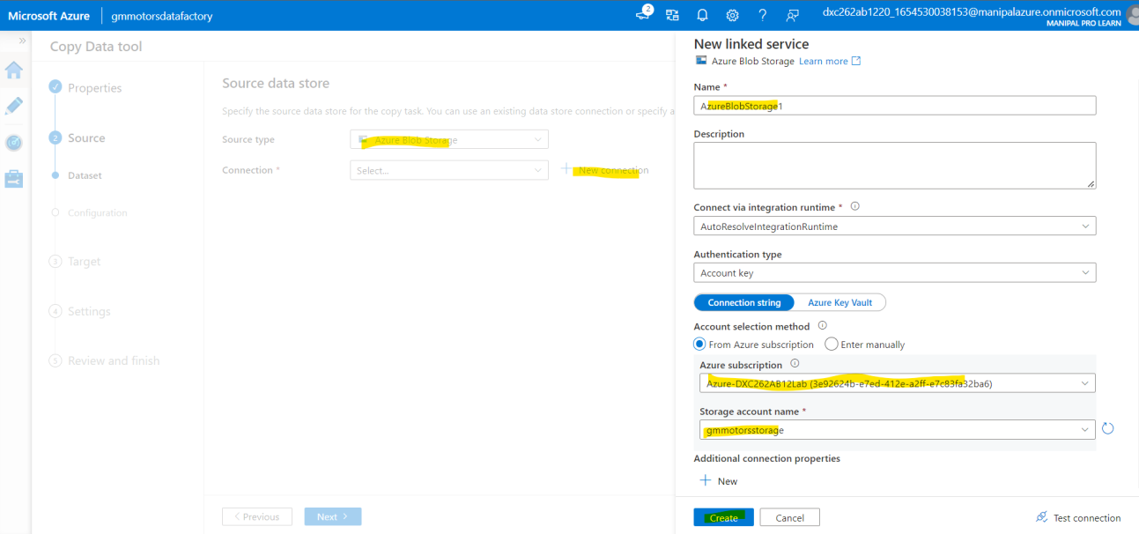
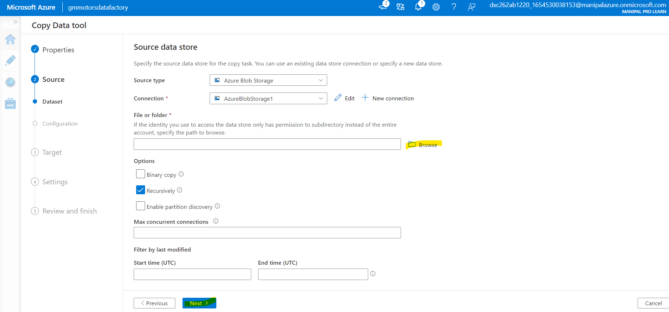
Select the blob storage and click on create.
Select source data
to connect and click on next.

Slide 20
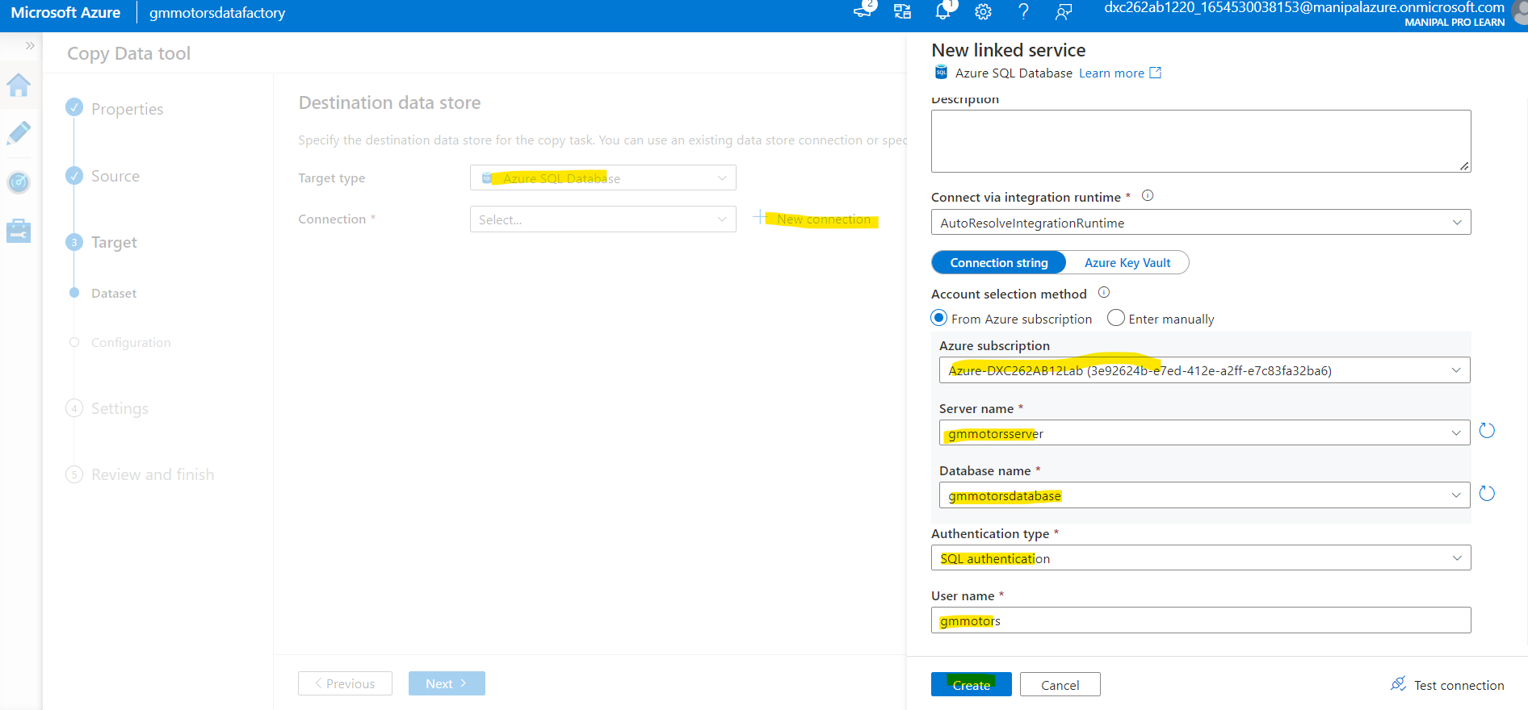
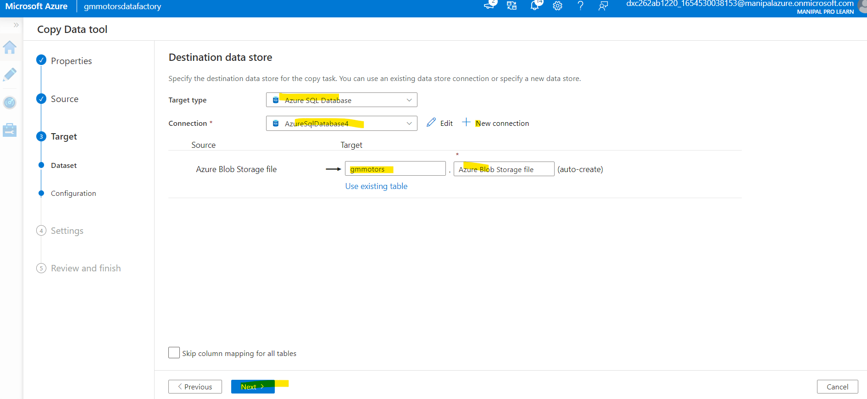
Now we will connect the Azure Data Factory with SQL Database. Which is destination for data.
Name the table for data
and click on next.

Slide 21
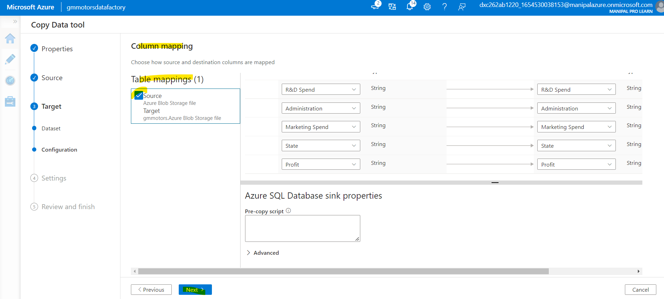
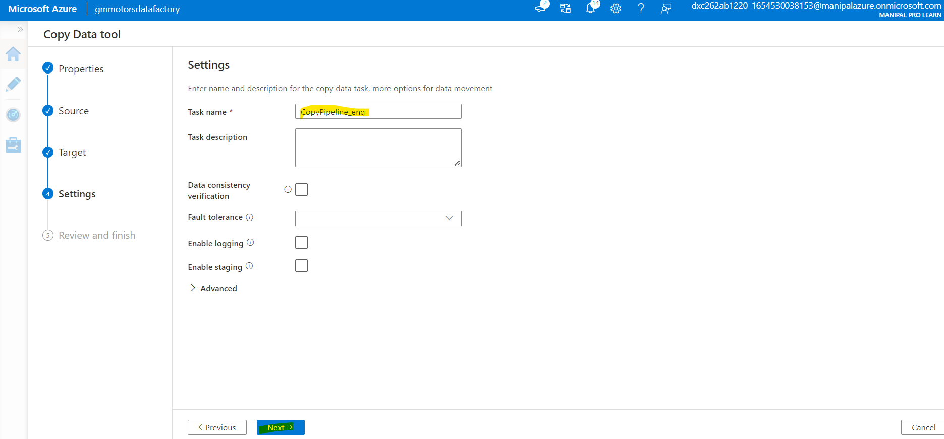
Table mapping can be seen here, Click on next.
Pipeline is being created, Click on next.

Slide 22
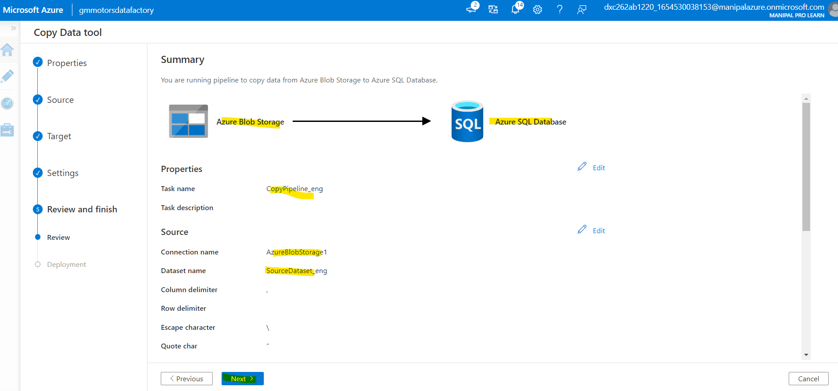
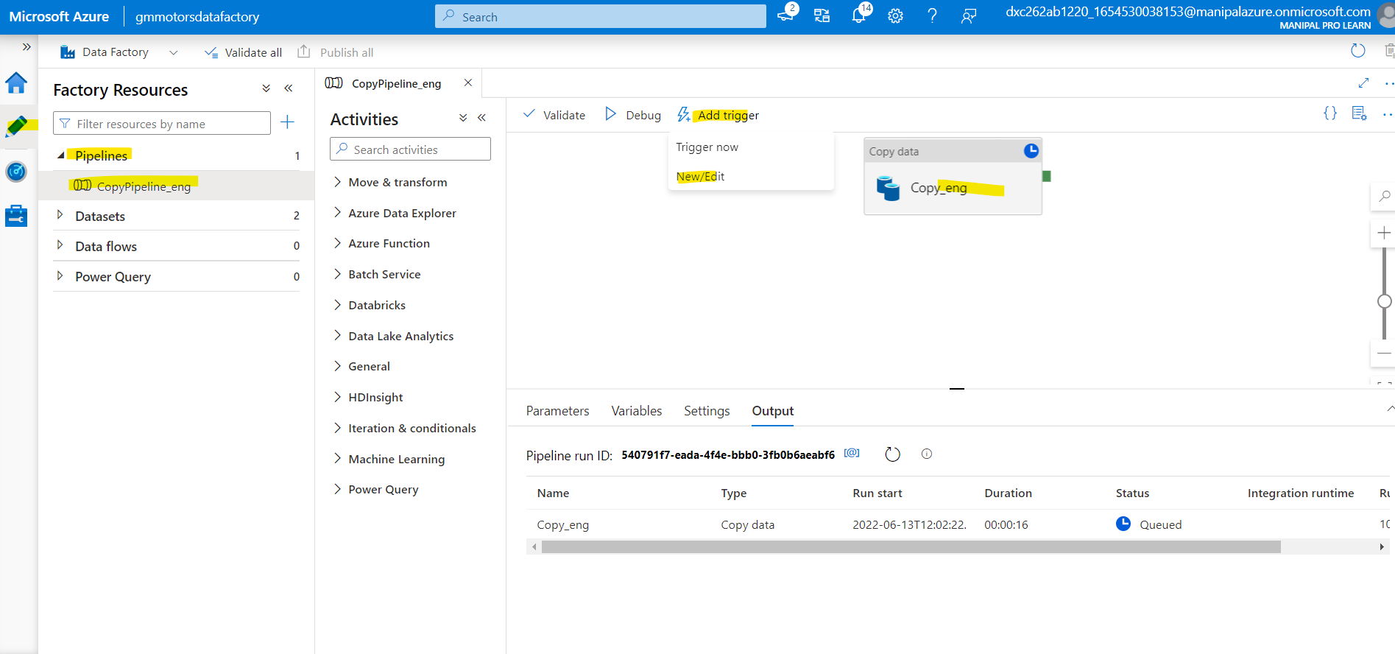
Review the data and click on next.
Now trigger the data manually.

Slide 23
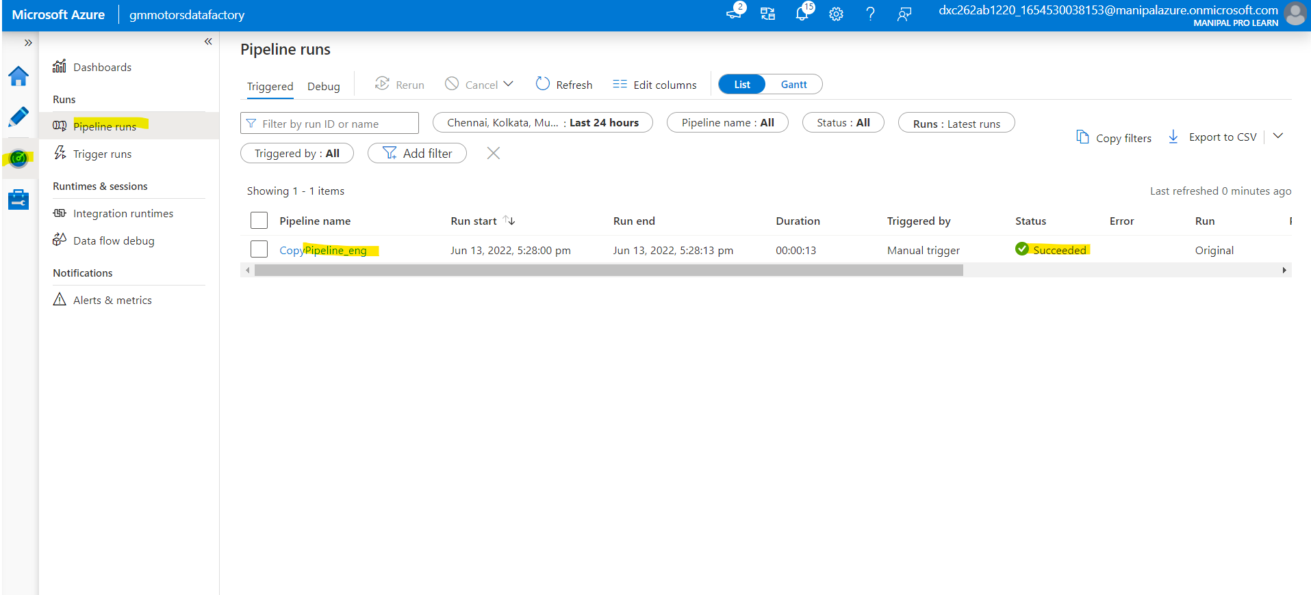
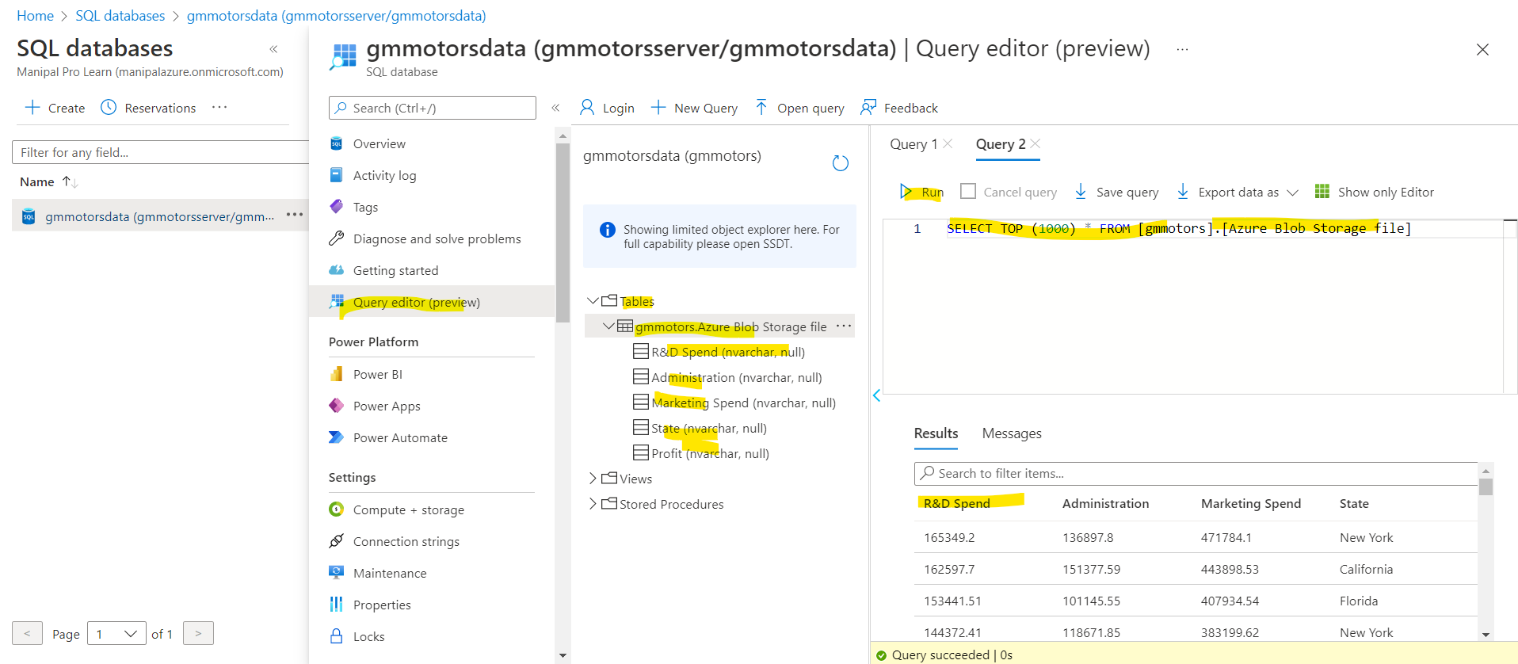
Navigate to monitor and we can see that pipeline is being triggered.
In SQL Database we can check the data.

Slide 24
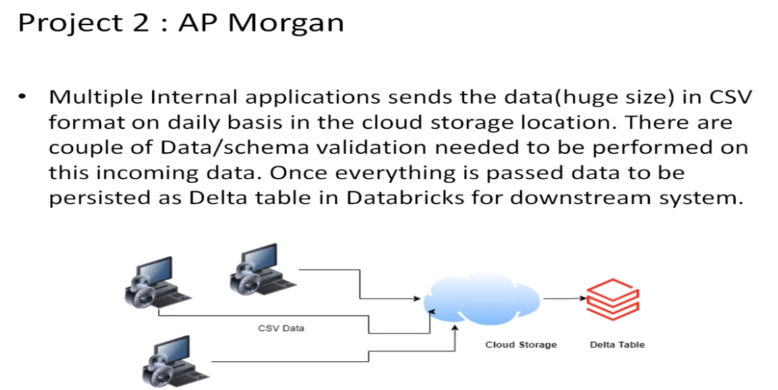
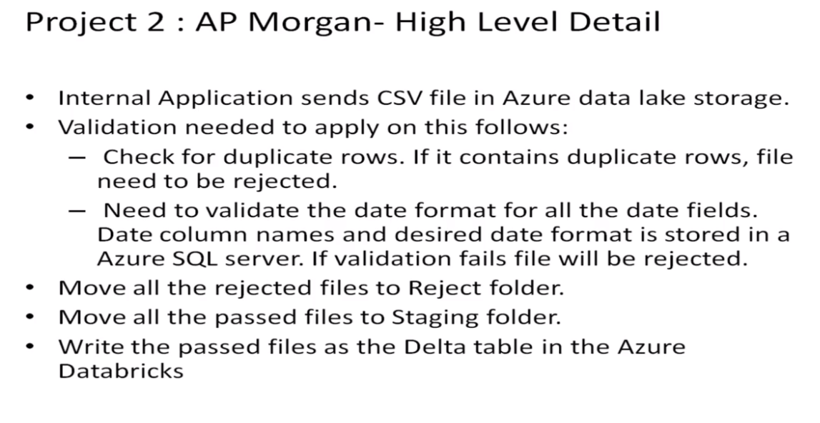
Project - 2

Slide 25
TASK 1. Practical Lab: Create a Databricks
TASK 2. Practical Lab: Create Cluster in Azure Databricks
TASK 3.Practical Lab: Add notebook in Databricks and Implement the Business Logic.
TASK 4. Practical Lab: Azure Data Factory For AP Morgan
TASK 5.Practical Lab: Create Azure Databricks Linked Service in ADF

Slide 26
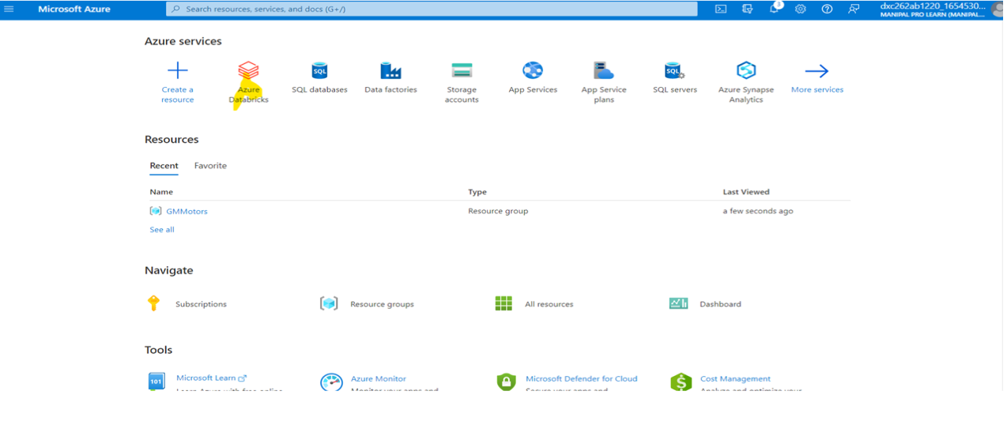
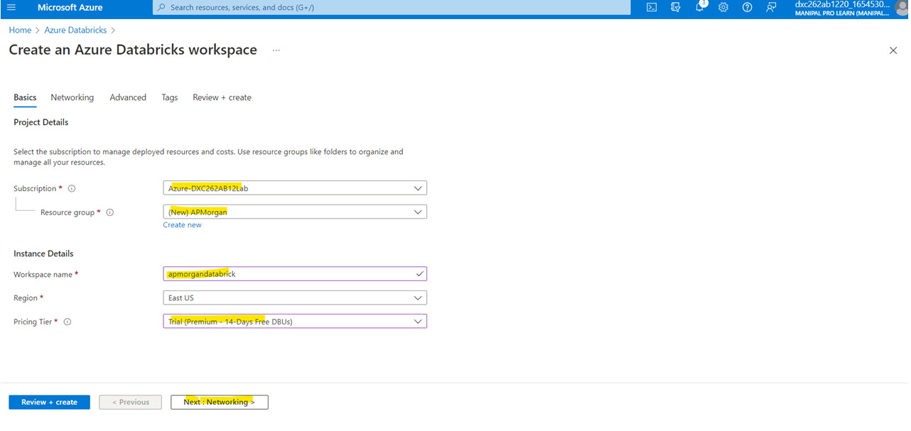
Create a Data Brick
Fill all the required fields.

Slide 27
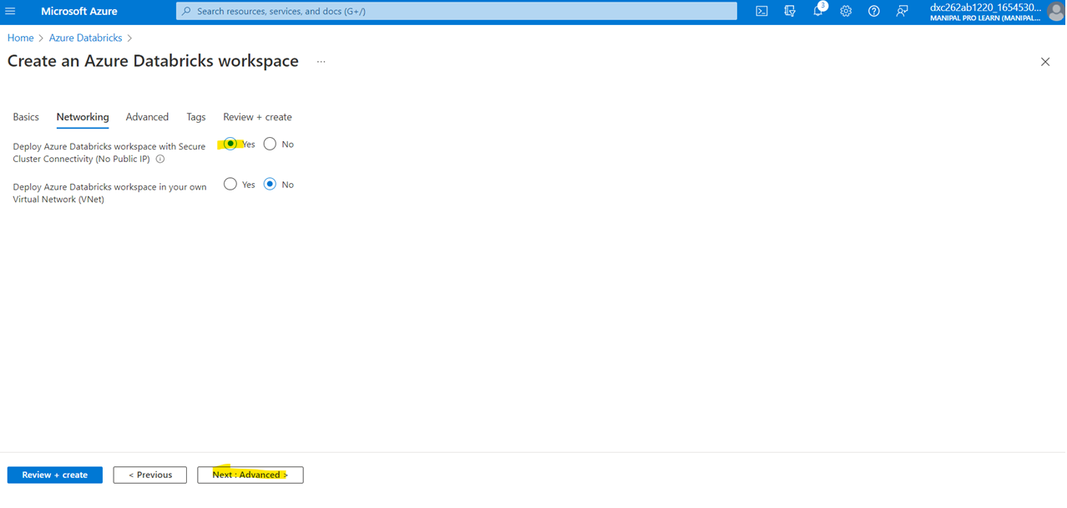
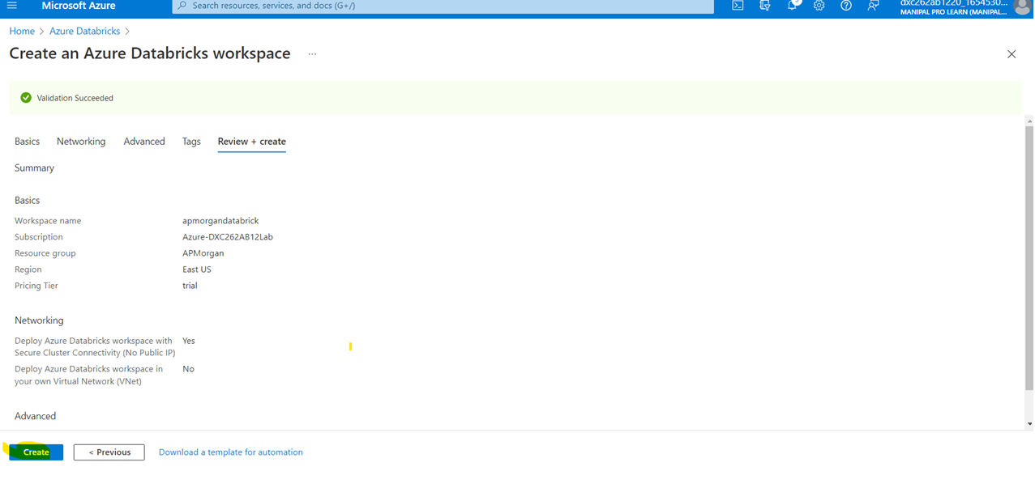
Click on yes in connecting via cluster.
Review the data and click on create.

Slide 28
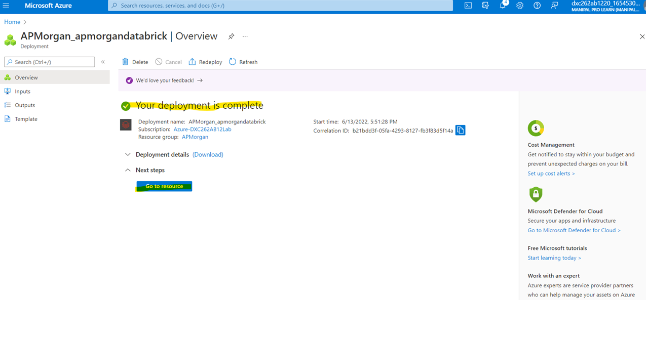
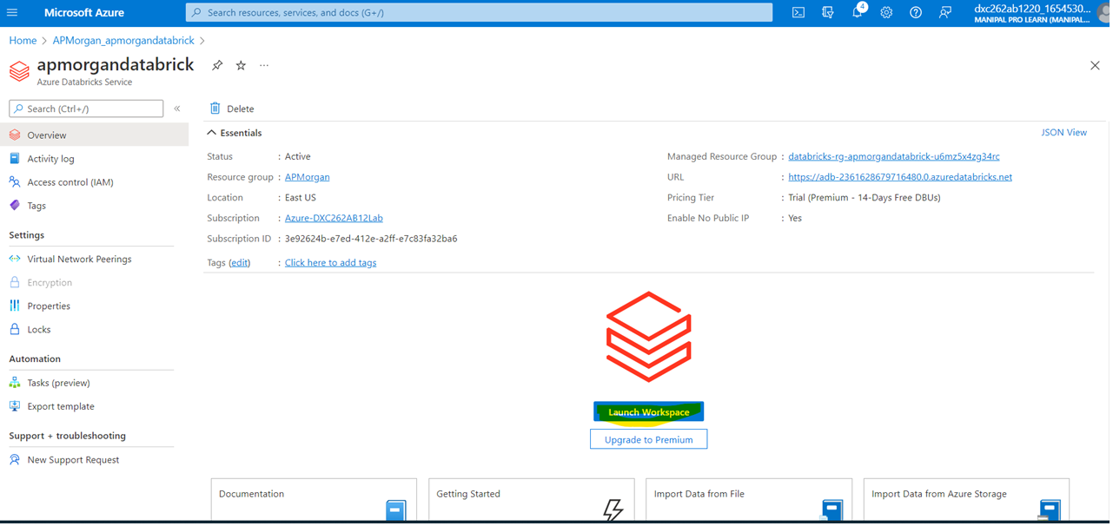
After deployment is completed click on go to resources.
Click on launch workspace.

Slide 29
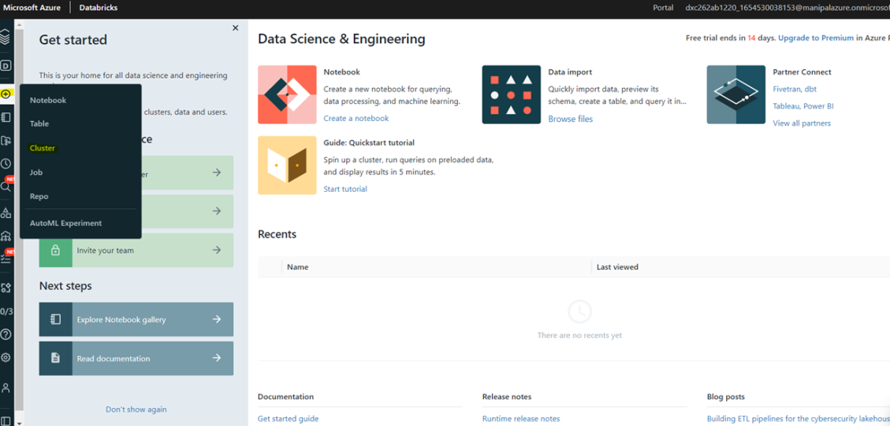
Now we need to create a cluster.

Slide 30
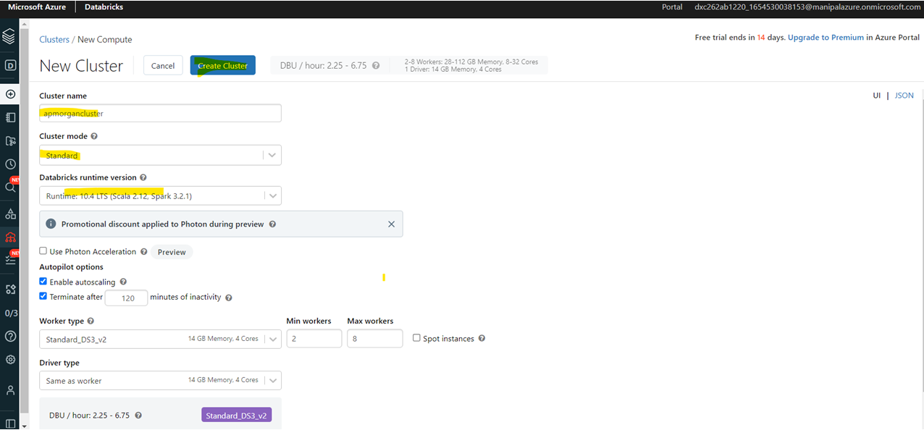
Fill all required details for creating cluster and click on create cluster.

Slide 31
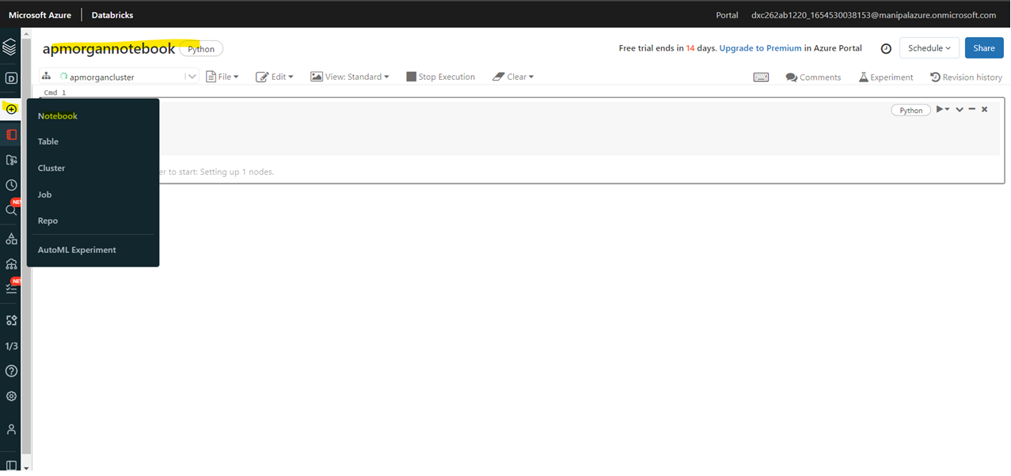
Now we need to create a notebook for computation purpose.

Slide 32
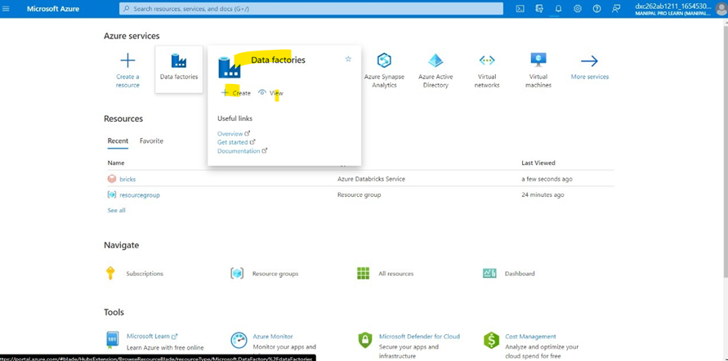
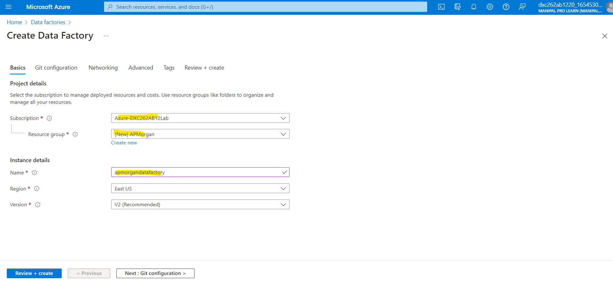
Now go to azure home and create a Azure Data Factory.
Fill all the required details.

Slide 33
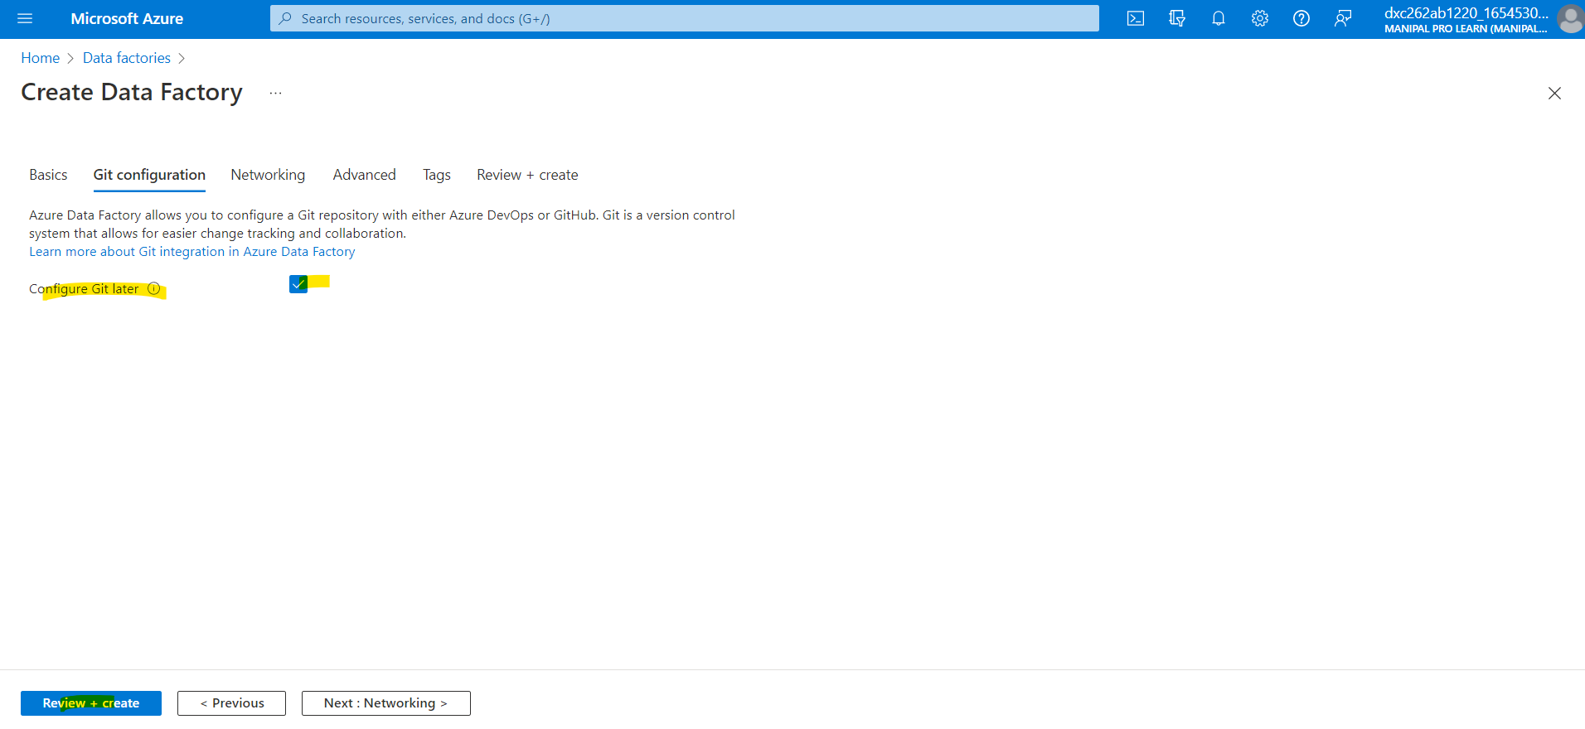
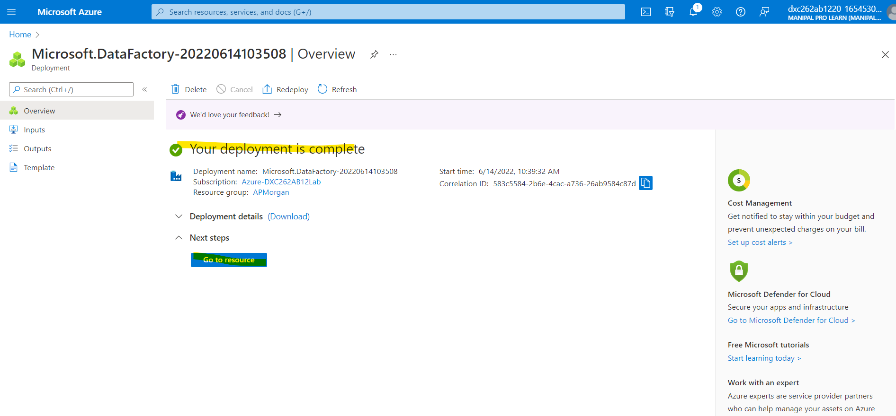
Check box for configuring git later and click on review + create and click on create.
After deployment is complete, Click on go to resources.

Slide 34
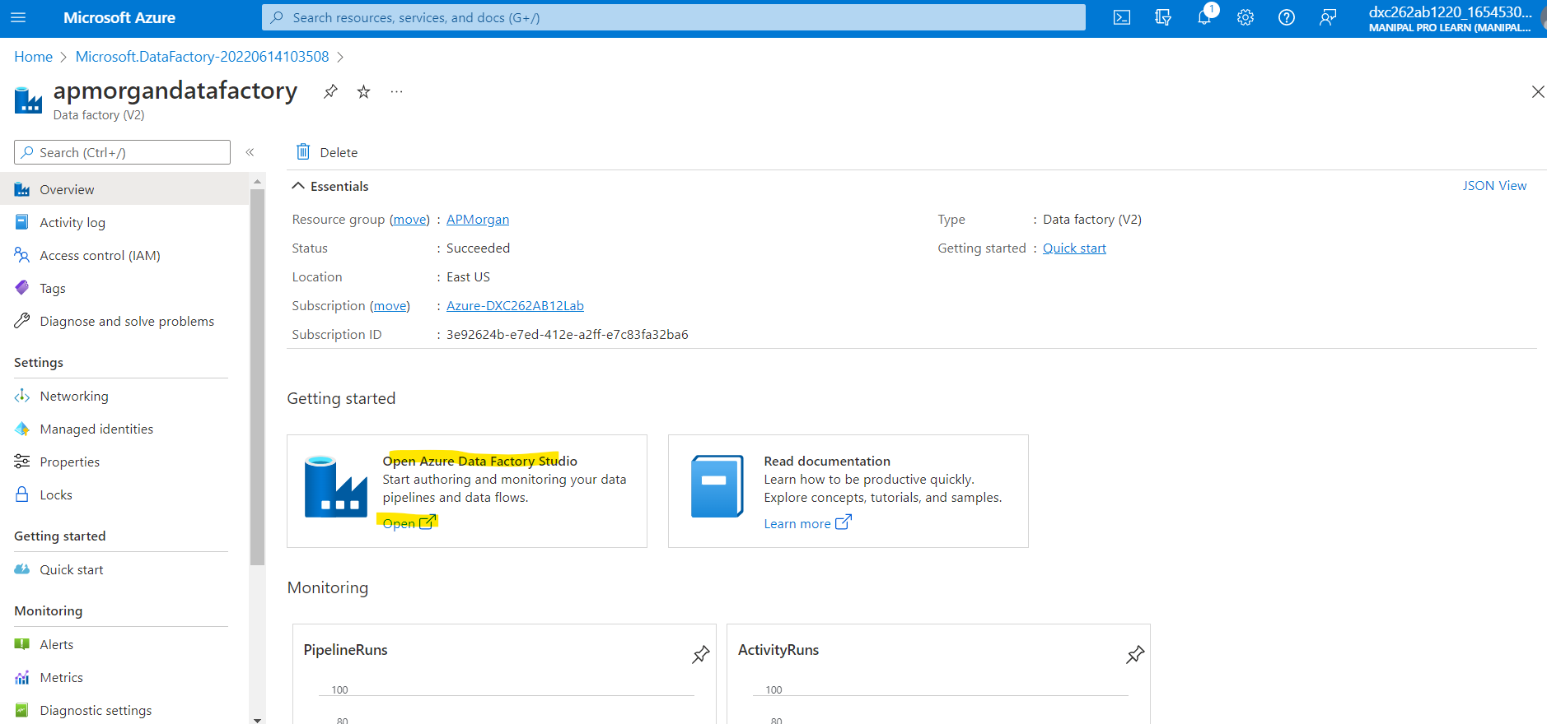
Now open the Data Factory studio.

Slide 35
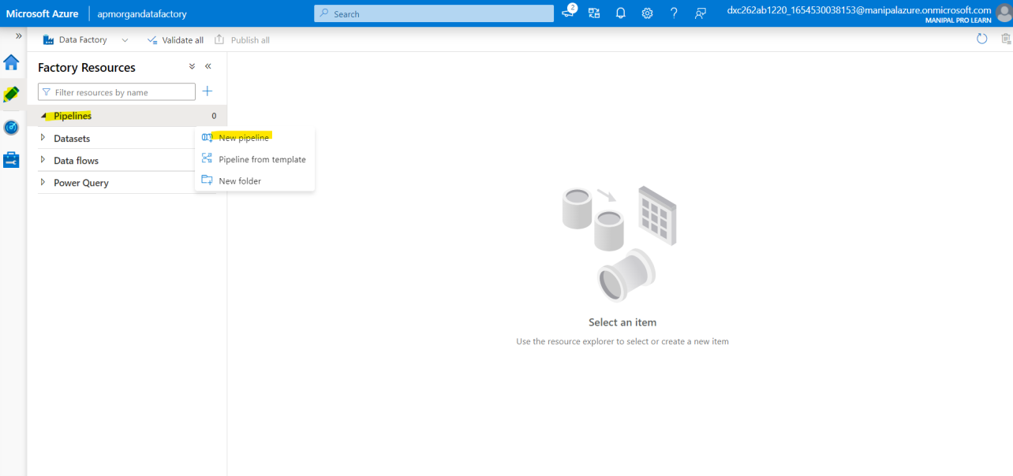
We need to create a pipeline that will connect Data Bricks notebook with Data Factory.

Slide 36
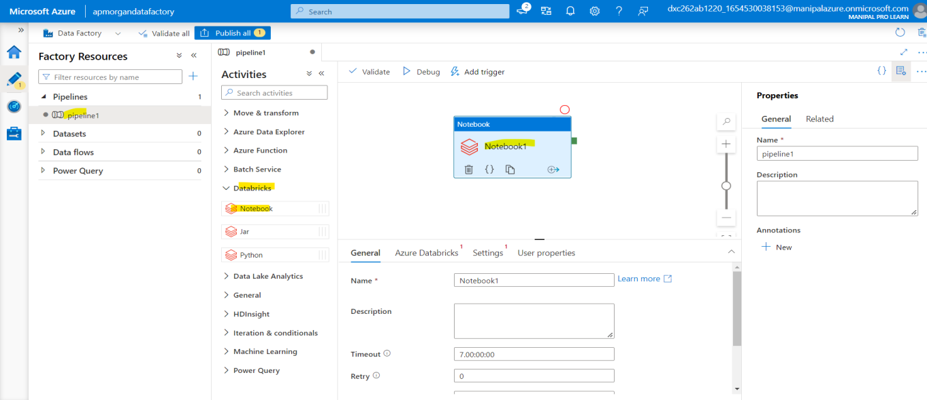
Now we need to add Databrick Notebook to our pipeline.

Slide 37

Create a new Linked service for databricks

Slide 38


We need the access token of Data bricks account in order to access it.
Navigate to Data bricks workspace and go to Users settings
Click on Generate token.

Slide 39

Now paste the access token in azure data factory connect dialog box.

Slide 40

Choose cluster version, node type and python version and click on create.

Slide 41


Choose notebook path.
Publish the pipeline.

Slide 42

Trigger the pipeline

Slide 43

To see the pipeline running, Go to monitor and can check it.
Both projects have been successfully done.

Slide 44
Thank you

